Slide 1
C++ Programming Design
Session #3

Slide 2
#3 Dealing with Data
Rules for naming C++ variables
C++’s built-in integer types: unsigned long, long, unsigned int, int, unsigned short, short, char, unsigned char, signed char, bool
C++11’s additions: unsigned long long and long long
The climits file, which represents system limits for various integer types
Numeric literals (constants) of various integer types
Using the const qualifier to create symbolic constants

Slide 3
#3 Dealing with Data
C++’s built-in floating-point types: float, double, and long double
The cfloat file, which represents system limits for various floating-point types
Numeric literals of various floating-point types
C++’s arithmetic operators
Automatic type conversions
Forced type conversions (type casts)

Slide 4
Simple Variables
To store an item of information in a computer, the program must keep track of three fundamental properties:
(1)Where the information is stored
(2)What value is kept there
(3)What kind of information is stored
Example:
int braincount = 5;

Slide 5
Simple Variables: Name Rules
The only characters you can use in names are alphabetic characters, numeric digits, and the underscore (_) character.
The first character in a name cannot be a numeric digit.
Uppercase characters are considered distinct from lowercase characters.
You can’t use a C++ keyword for a name.
Reserved names.
C++ places no limits on the length of a name.

Slide 6
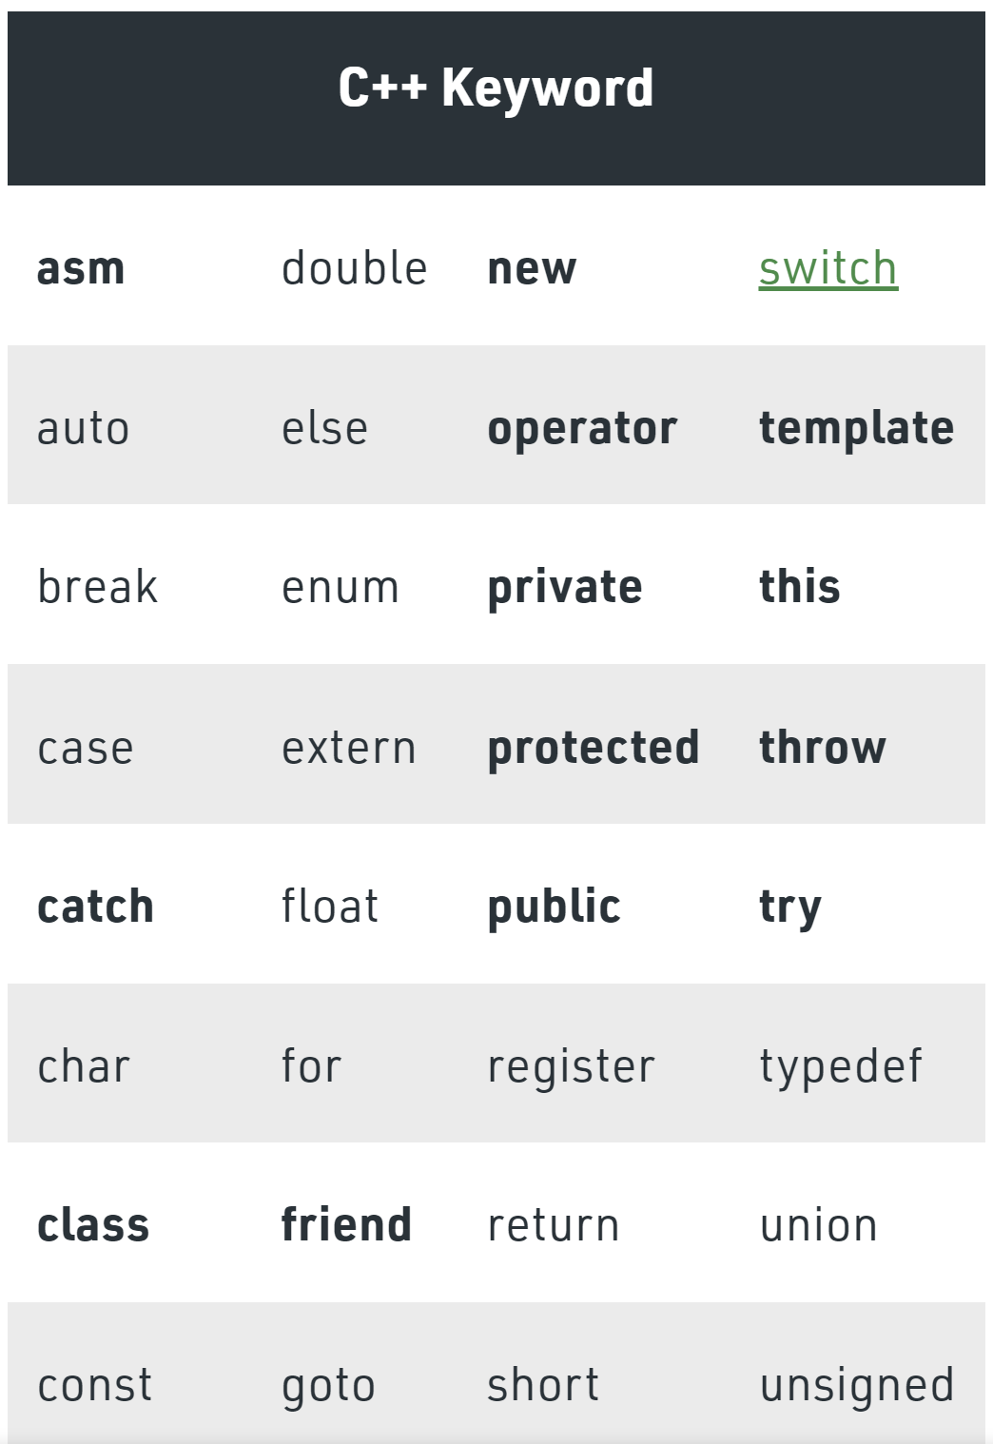
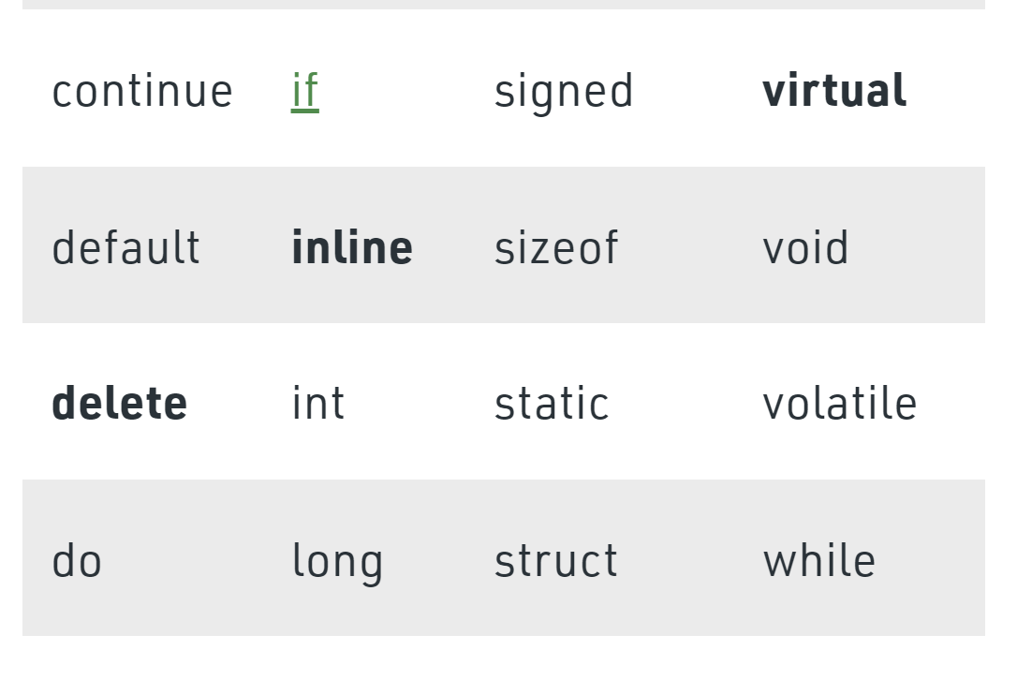

Slide 7
Simple Variables: Integer Types
char, short, int, long, and, with C++11, long long.
signed and unsigned
C++ offers a flexible standard with some guaranteed minimum sizes
sizeof operator: sizeof int/variable or sizeof (int)
climits header file: listing below

Slide 8
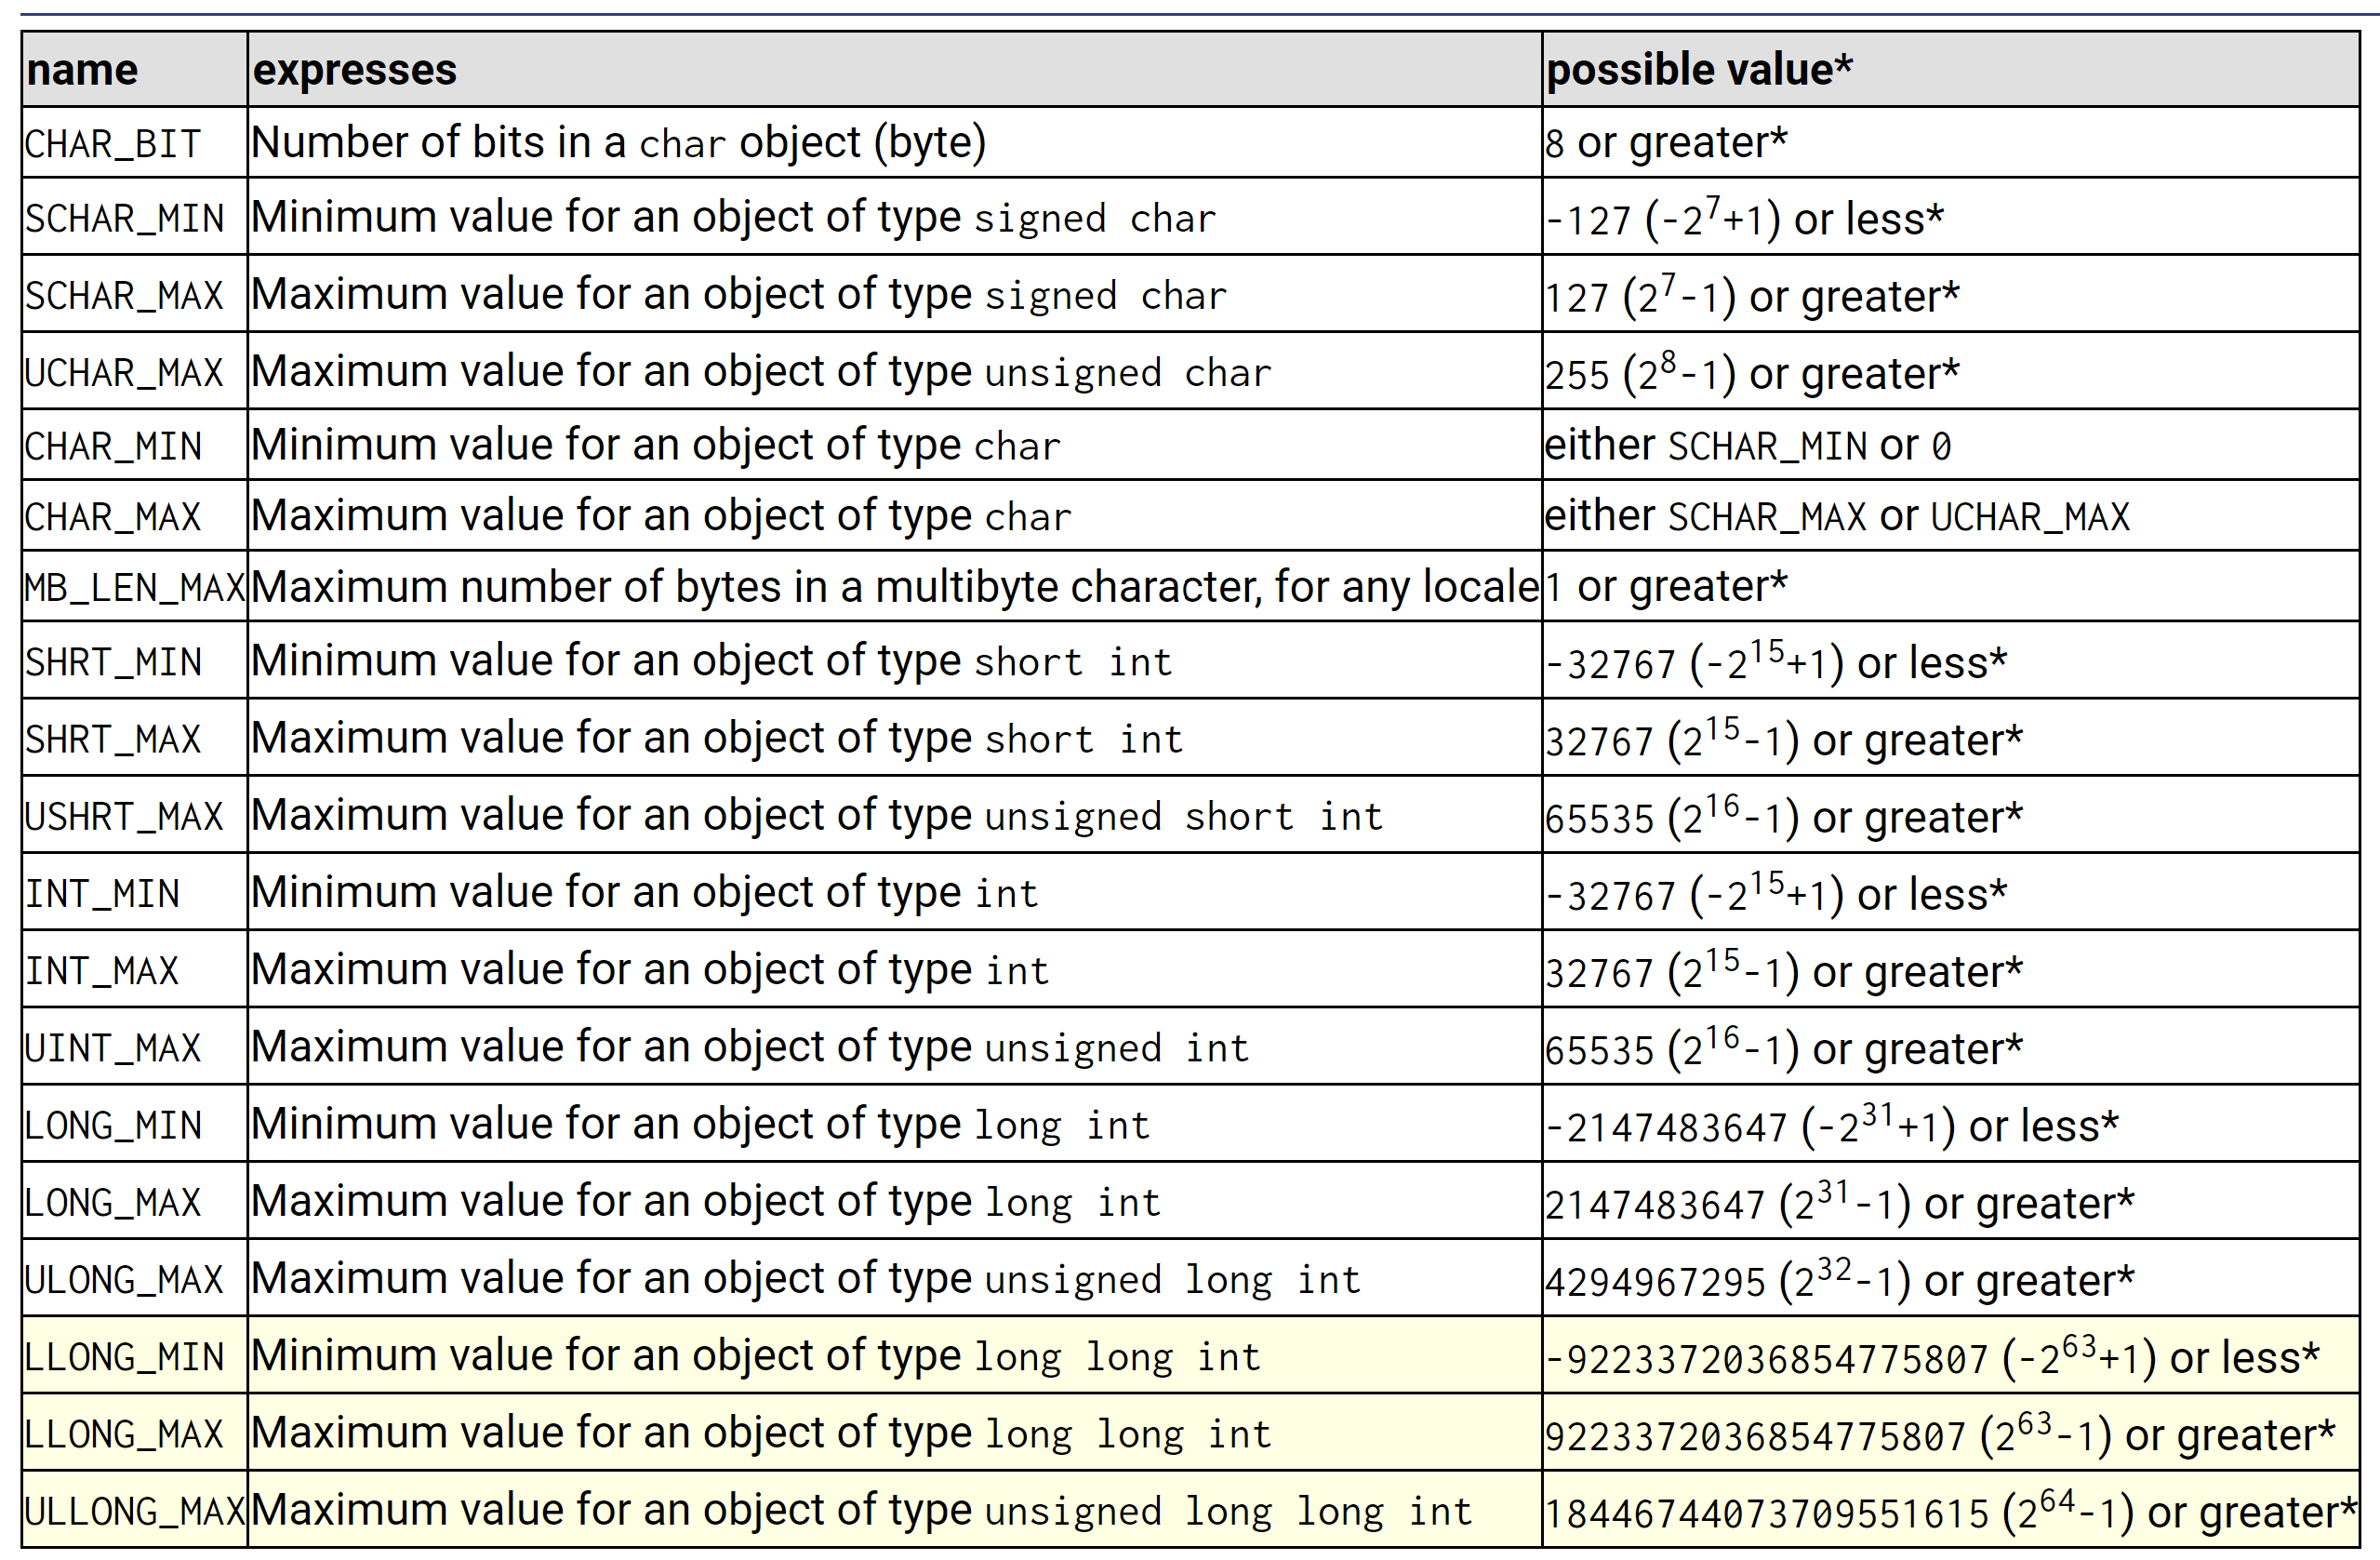
Simple Variables: climits header file

Slide 9
Simple Variables: Initialization
The initialization syntax shown previously comes from C; C++ has an initialization syntax that is not shared with C:
int owls = 101; // traditional C initialization, sets owls to 101
int wrens(432); // alternative C++ syntax, set wrens to 432

Slide 10
Simple Variables: Initialization C++11
int emus{7}; // set emus to 5
int rheas = {12}; // set rheas to 12
int rocs = {}; // set rocs to 0
int psychics{}; // set psychics to 0

Slide 11
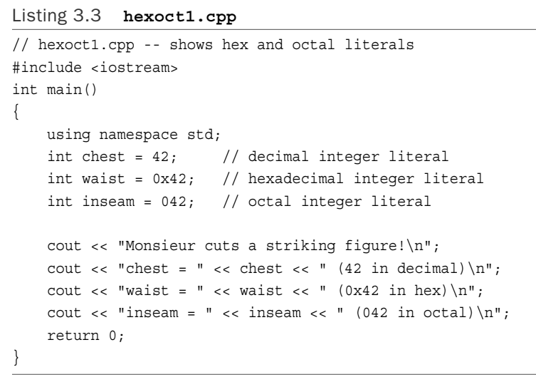
Simple Variables: Integer Literals as int

Slide 12
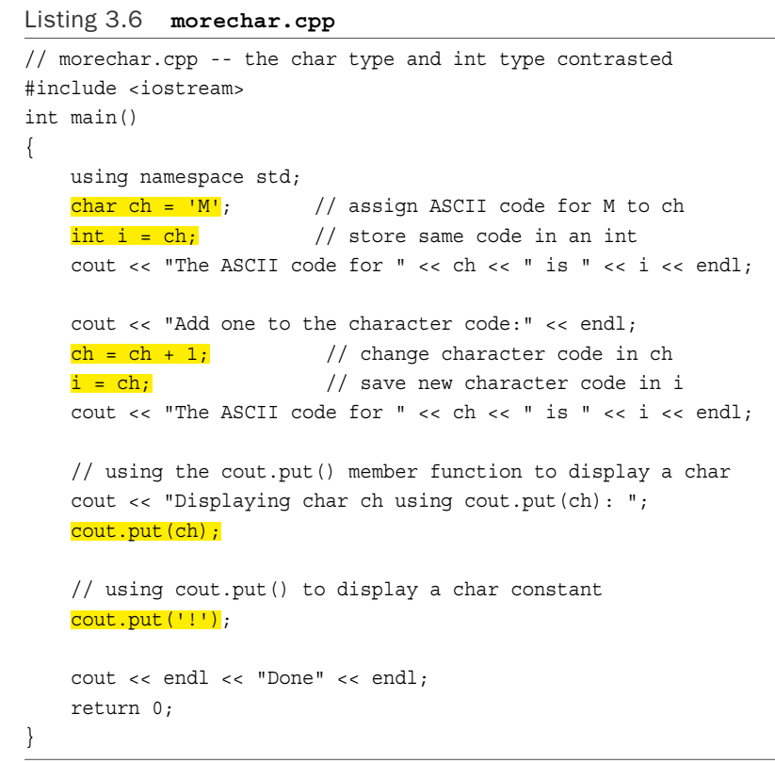
Simple Variables: char

Slide 13
Simple Variables: Char
char, unsigned char, signed char
Example:
char fodo; // may be signed, may be unsigned
unsigned char bar; // definitely unsigned
signed char snark; // definitely signed
New C++11 Types: char16_t and char32_t

Slide 14
Simple Variables: bool
New C++ type
Two literals: true or false
Examples:
(1)bool is_ready = true;
(2) int ans = true; // ans assigned 1
int promise = false; // promise assigned 0
(3) bool start = -100; // start assigned true
bool stop = 0; // stop assigned false

Slide 15
The const Qualifier
The general form for creating a constant is:
const type name = value;
Example：
const int Months = 12;

Slide 16
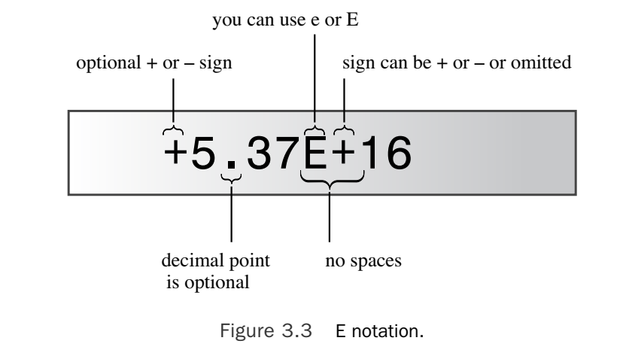
Floating-Point Numbers
float, double, long double
Examples: 12.34 or 5.37E+16
cfloat header file

Slide 17
Floating-Point Numbers
Advantages：
(1)represent values between integers
(2) represent a much greater range of values
Disadvantages:
(1)slightly slower than integer operations
(2)lose precision

Slide 18
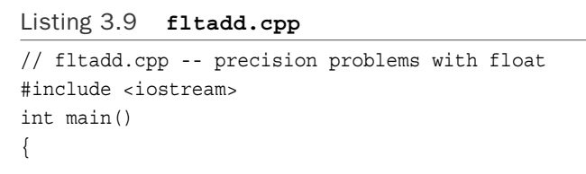
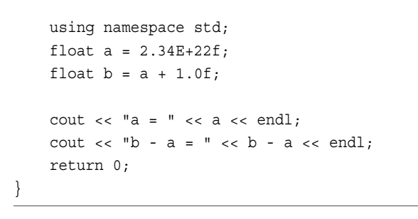
Floating-Point Numbers: Precision

Slide 19
C++ Arithmetic Operators
+,-,*,/,%, …
Order of Operation: Operator Precedence and Associativity
Division Diversions: 5/4, 5.0/4

Slide 20
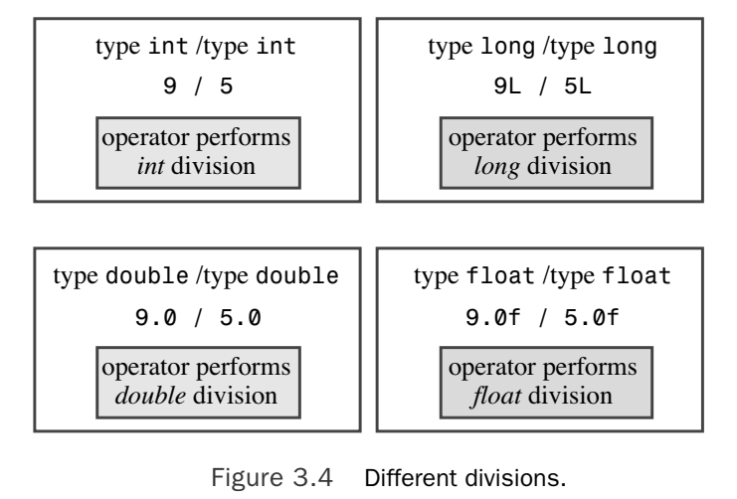
C++ Arithmetic Operators: Overloading

Slide 21
C++ Arithmetic Operators: Type Conversions
C++ makes many type conversions automatically:
(1)C++ converts values when you assign a value of one arithmetic type to a variable of another arithmetic type.
(2) C++ converts values when you combine mixed types in expressions.
(3)C++ converts values when you pass arguments to functions.

Slide 22
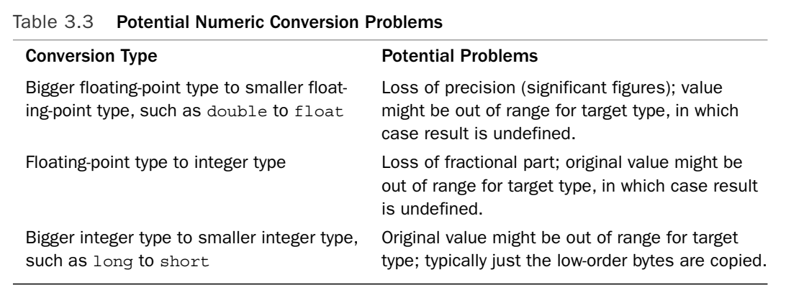
C++ Arithmetic Operators: Type Conversions

Slide 23
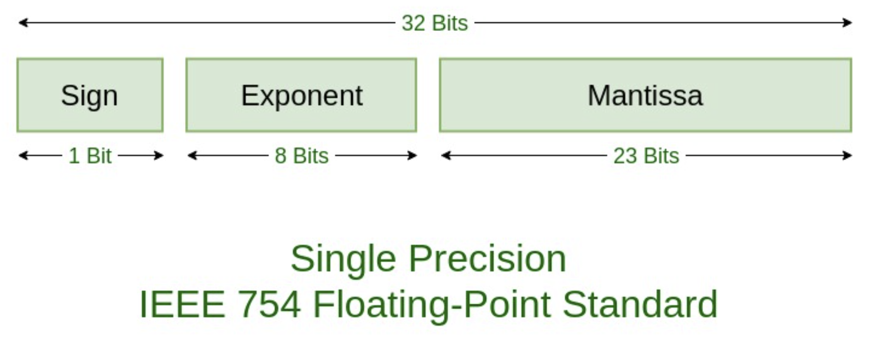
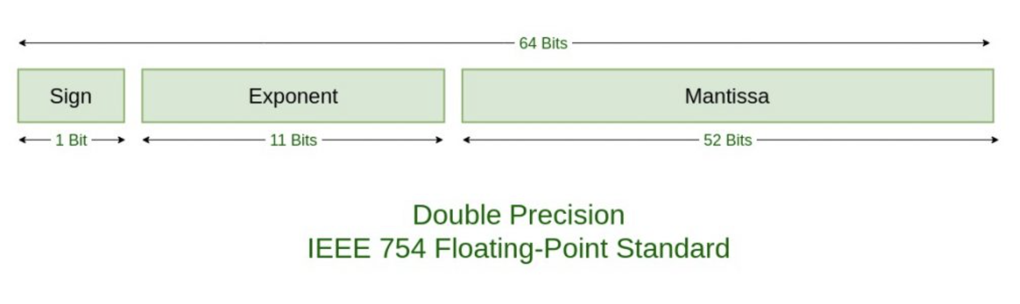

Slide 24
C++ Arithmetic Operators: Type Conversions
Initialization Conversions When {} Are Used (C++11)
Examples:
const int code = 66;
int x = 66;
char c1 {31325}; // narrowing, not allowed
char c2 = {66}; // allowed because char can hold 66
char c3 {code}; // ditto
char c4 = {x}; // not allowed, x is not constant
x = 31325;
char c5 = x; // allowed by this form of initialization

Slide 25
C++ Arithmetic Operators: Type Cast
int thorn=1;
(long) thorn //From C
long (thorn) // New C++
C++ also introduces four type cast operators.

Slide 26
C++ Arithmetic Operators: auto in C++11
Automatic type deduction
Examples:
(1)auto n = 100; // n is int
(2)auto x = 1.5; // x is double
(3)auto y = 1.3e12L; // y is long double
Another examples:
suppose x, y, and z are all intended to be type double:
(1)auto x = 0.0; // ok, x is double because 0.0 is double
(2)double y = 0; // ok, 0 automatically converted to 0.0
(3)auto z = 0; // oops, z is int because 0 is int

Slide 27
Programming Exercises

Slide 28
Programming Exercises
3.1 Write a short program that asks for your height in feet and inches and your weight in pounds. (Use three variables to store the information.) Have the program report your body mass index (BMI).To calculate the BMI, first convert your height in feet and inches to your height in inches (1 foot = 12 inches).Then convert your height in inches to your height in meters by multiplying by 0.0254.Then convert your weight in pounds into your mass in kilograms by dividing by 2.2. Finally, compute your BMI by dividing your mass in kilograms by the square of your height in meters. Use symbolic constants to represent the various conversion factors.
Notes:
1 inch = 2.54 centimeter

Slide 29
Programming Exercises
3.2 Write a program that asks the user to enter the number of seconds as an integer value (use type long, or, if available, long long) and that then displays the equivalent time in days, hours, minutes, and seconds. Use symbolic constants to represent the number of hours in the day, the number of minutes in an hour, and the number of seconds in a minute.

Slide 30
Programming Exercises
3.3 Write a program that asks you to enter an automobile gasoline consumption figure
in the European style (liters per 100 kilometers) and converts to the U.S. style of miles per gallon. Note that in addition to using different units of measurement, the U.S. approach (distance / fuel) is the inverse of the European approach (fuel / distance). Note that 100 kilometers is 62.14 miles, and 1 gallon is 3.785 liters. Thus, 19 mpg is about 12.4 l/100 km, and 27 mpg is about 8.7 l/100 km.

